Slide 1

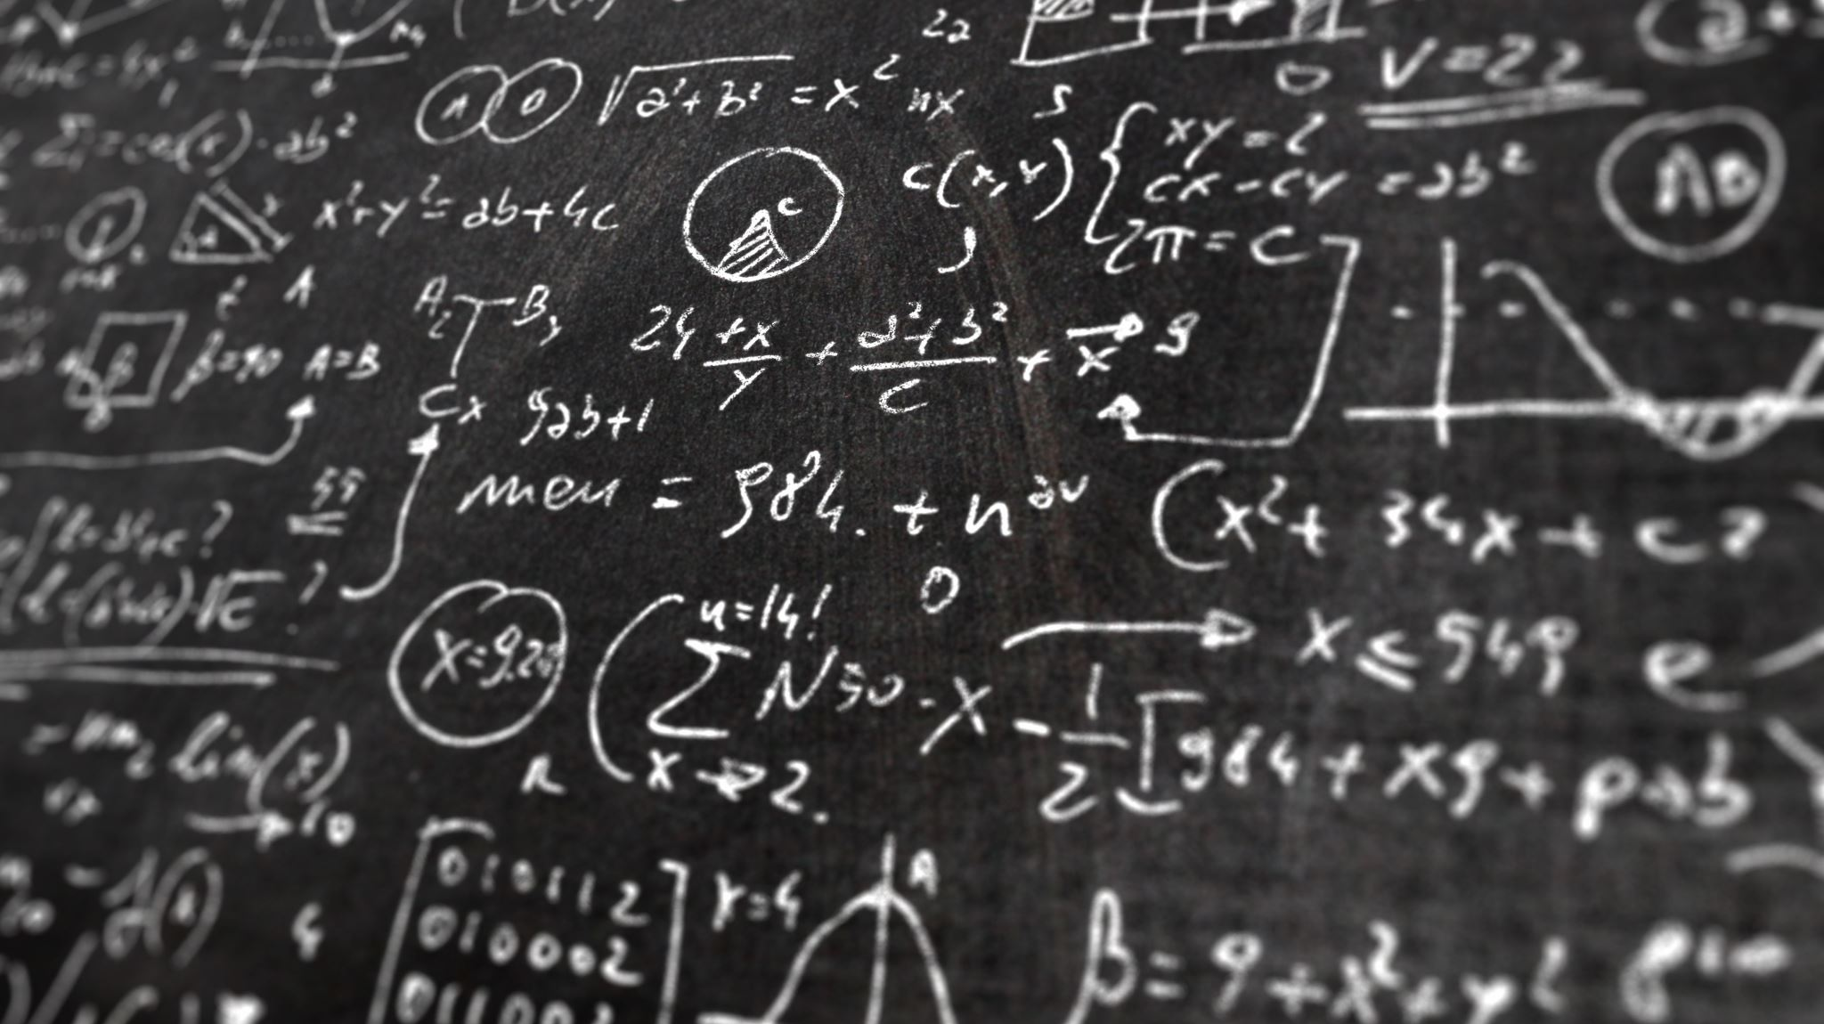
K-Nearest NEIGHBOR algorithm

Slide 2
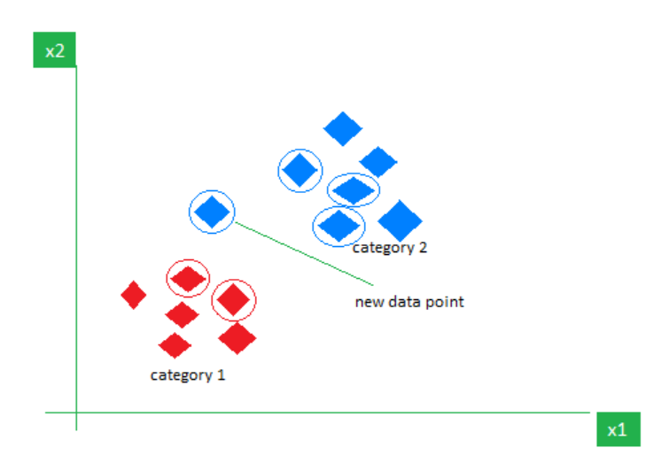
Introduction
The K-Nearest Neighbor (KNN) algorithm is a supervised learning algorithm in which is output value of data is known, but how to get the output is not known.
The KNN algorithm stores all available cases and classifies new cases by a majority vote of its k neighbor.
KNN is a non-parametric supervised learning algorithm which classifies data into a particular category with the help of training set.
KNN uses all of the data for training while classifying a new data point or instance.
The value for a new instance (x) is predicted by searching the training set for the k most similar cases and summarizing the output values for those k cases.

Slide 3
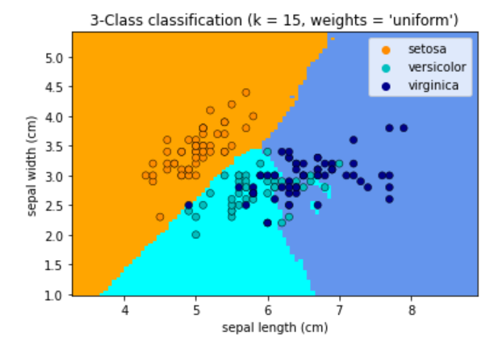
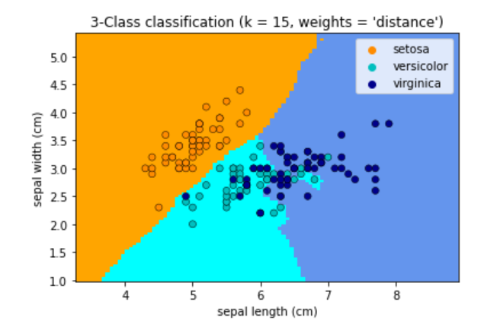
Nearest Neighbors Classification
Neighbors-based classification is a type of instance-based learning or non-generalizing learning.
Classification is computed from a simple majority vote of the nearest neighbors of each point.
A query point is assigned the data class which hat the most representatives within the nearest neighbors of the point.
The k-neighbors classification in KNeighborsClassifier is the most commonly used technique.
The basic nearest neighbors classification uses uniform weights: that is, the value assigned to a query point is computed from a simple majority vote of the nearest neighbors.

Slide 4
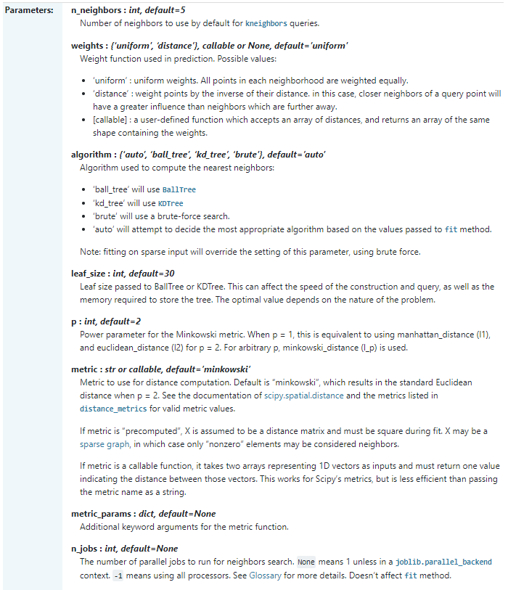
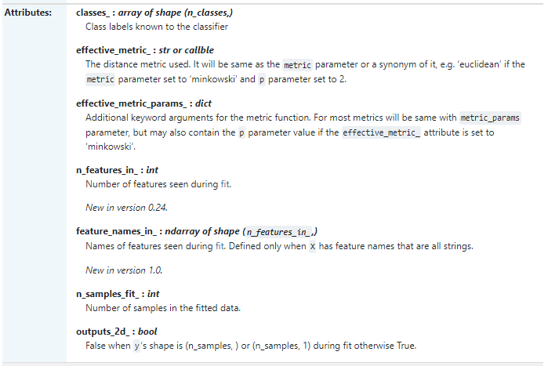
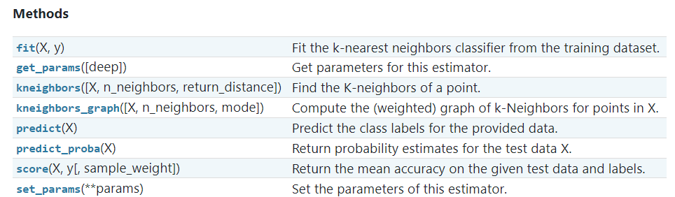
Sklearn.neighbors.KneighborsClassifier
class sklearn.neighbors.KNeighborsClassifier( n_neighbors = k, weights = ‘uniform’, algorithm = ‘auto’, leaf_size = 30, p = 2, metric = ‘minkowski’, metric_params = None, n_jobs = None)

Slide 5
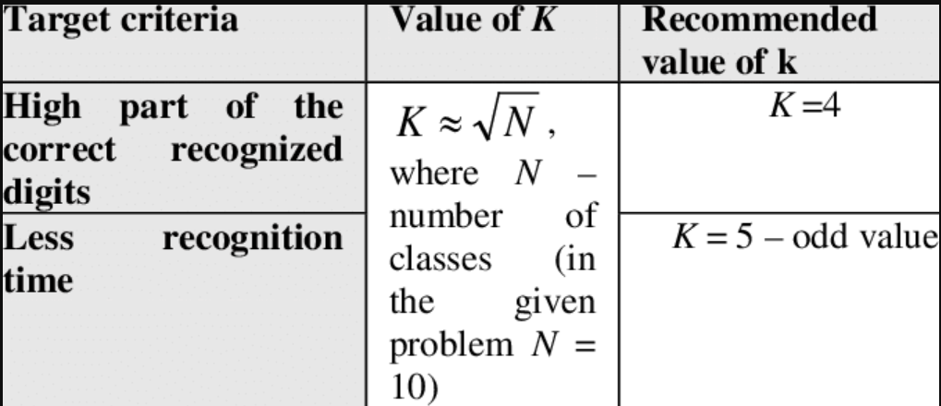
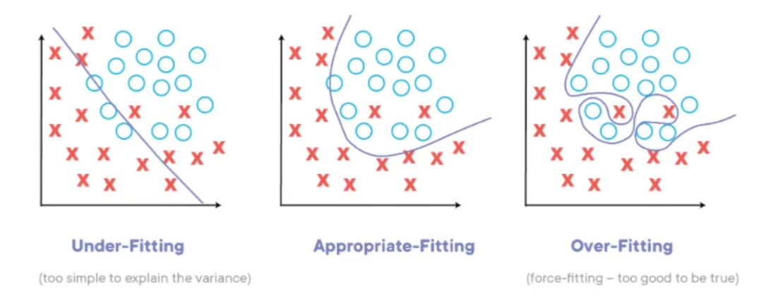
Choosing the Value of K
The value of k is very crucial in the KNN algorithm to define the number of neighbors in the algorithm.
The value of k in the k-nearest neighbors (k-NN) algorithm should be chosen based on the input data.
If the input data has more outliers or noise, a higher value of k would be better. It is recommended to choose an odd value for k to avoid ties in classification.
Cross-validation methods can help in selecting the best k value for the given dataset.
The best value of K can be selected by taking the square root of the number of rows in the data. For example if data has 1000 rows then the k value can be square root of 1000.
The value of k in the KNN algorithm is related to the error rate of the model. A small value of k could lead to overfitting as well as a big value of k can lead to underfitting.

Slide 6
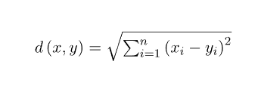


Distance Metrics Used In KNN Algorithm
Euclidean Distance : Euclidean distance can also be visualized as the length of the straight line that joins the two points which are into consideration
Manhattan Distance : This distance metric is generally used when we are interested in the total distance traveled by the object instead of the displacement. This metric is calculated by summing the absolute difference between the coordinates of the points in n-dimensions.
Minkowski Distance :

Slide 7
KNN is a Lazy Learner:
KNN doesn’t get’s generalized on train data, instead it relies on test data .
KNN doesn’t get’s generalized on train data, instead it relies on test data .
So, a lazy learner just stores the training data and waits for the test set.
Such algorithms work less while training and more while classifying a given test dataset.

Slide 8
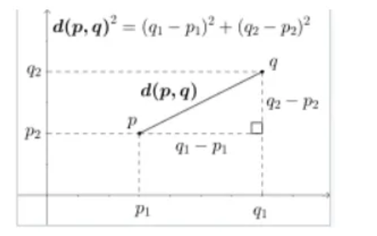
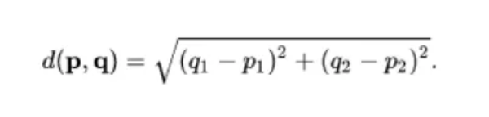
DISTANCE CALCULATION — To find the distance of nearest neighbors
There are many methods to find distance between the points , one such is Euclidean Distance.

Slide 9
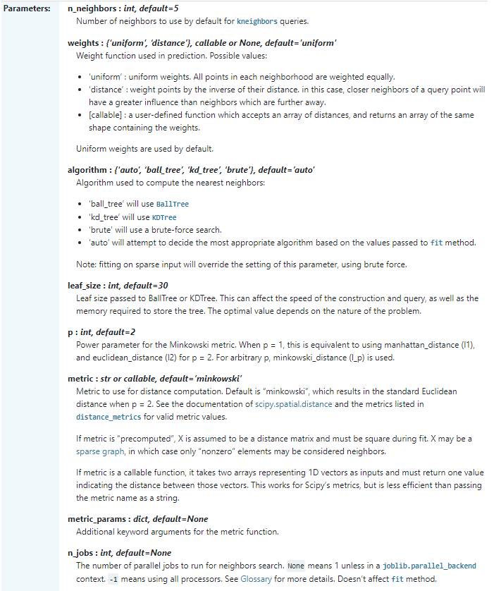
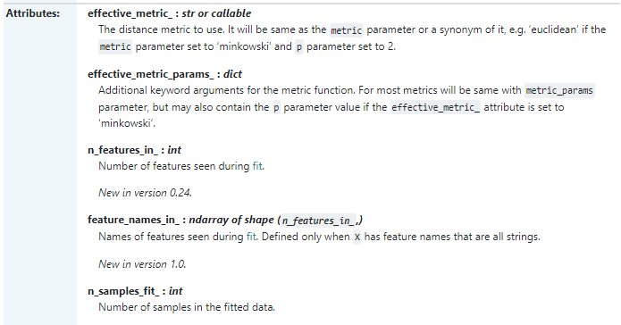
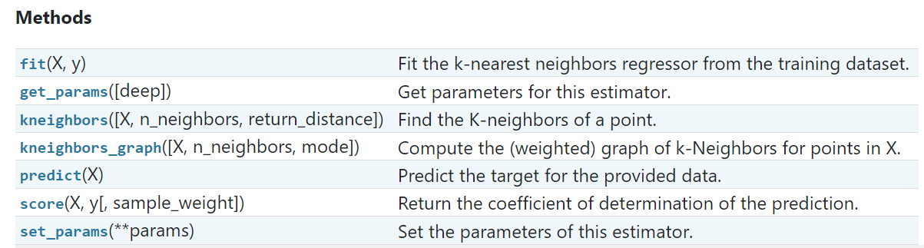
sklearn.neigbors.KNeighborRegressor
class sklearn.neighbors.KNeighborsRegressor(n_neighbors=5, *, weights='uniform', algorithm='auto', leaf_size=30, p=2, metric='minkowski', metric_params=None, n_jobs=None)

Slide 10
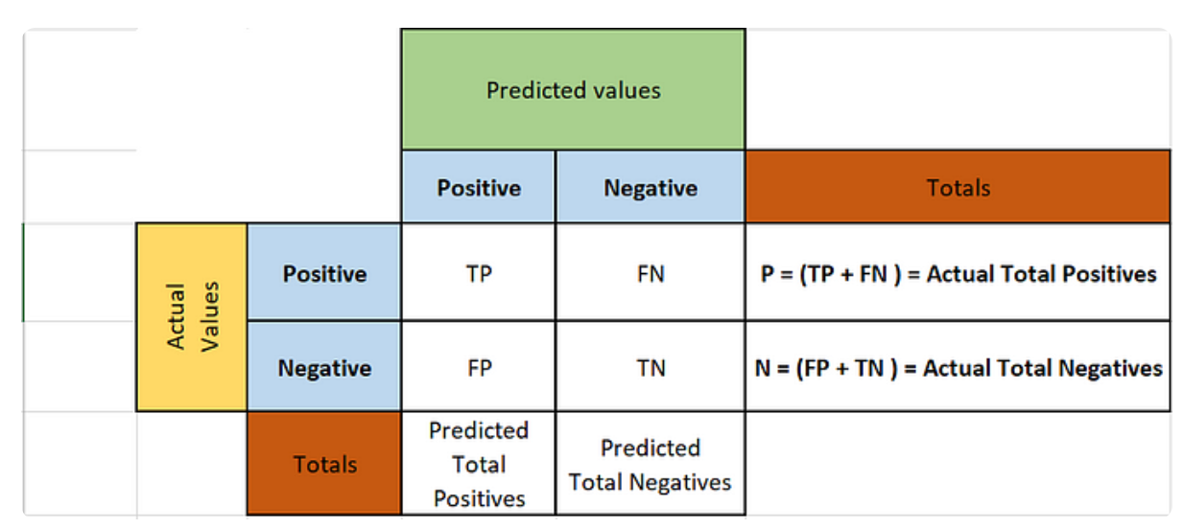
Understanding Confusion Matrix
Confusion matrix is one such important tool which helps us evaluate our model's performance.
It is a matrix of size n x n .where 'n' is the number of class labels in our problem.
True positive(TP): The number of instances that are correctly predicted as positive
True negative(TN): The number of instance that are correctly predicted as negative.
False positive(FP): the number of instances that are incorrectly predicted as positive.
False Negative( FN): The number of instances that are incorrectly predicted as negative

Slide 11
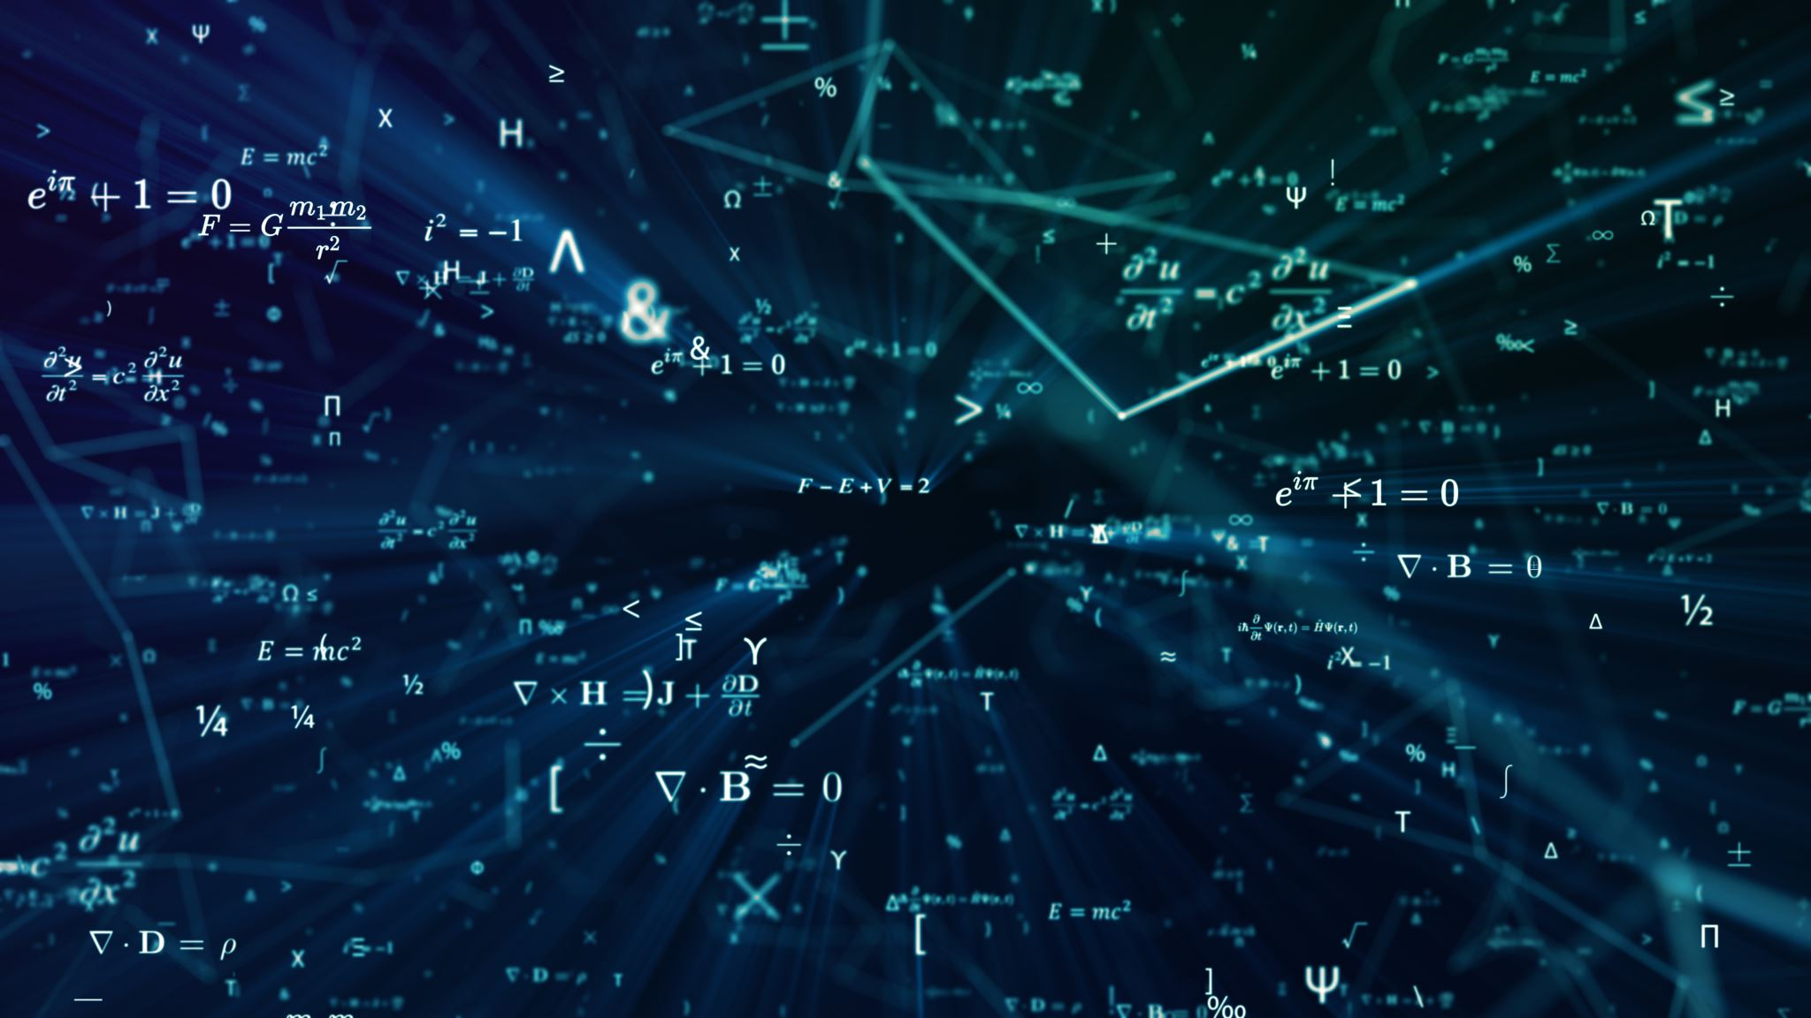
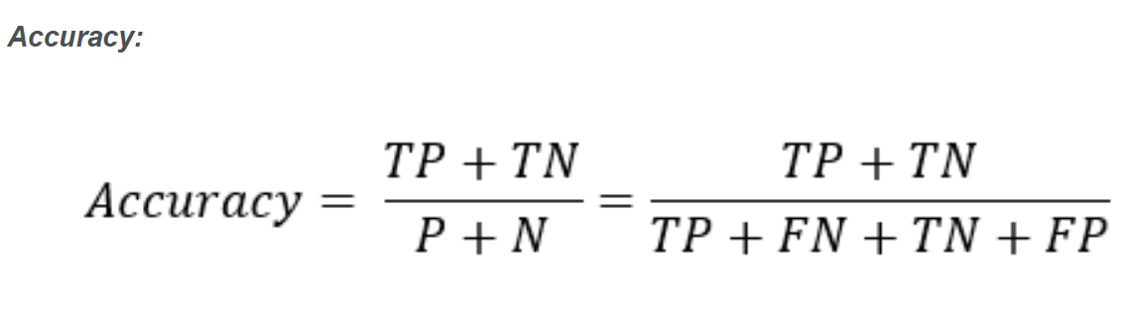
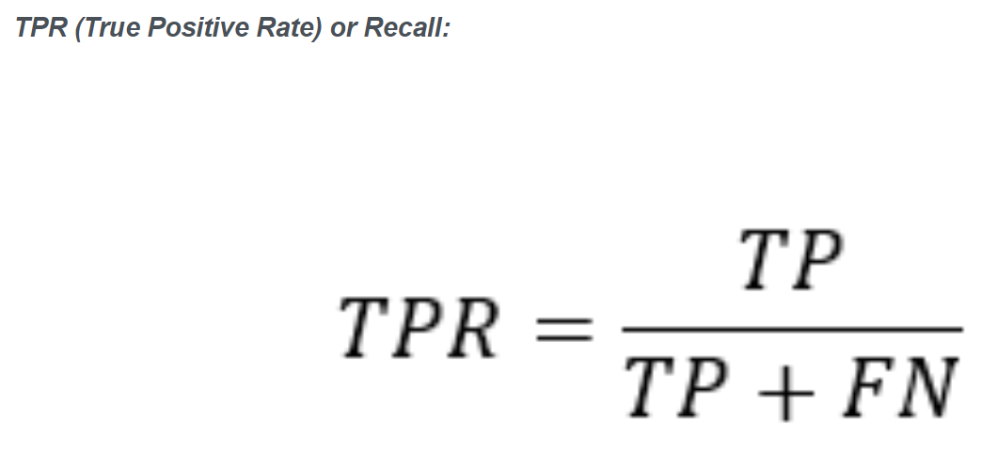
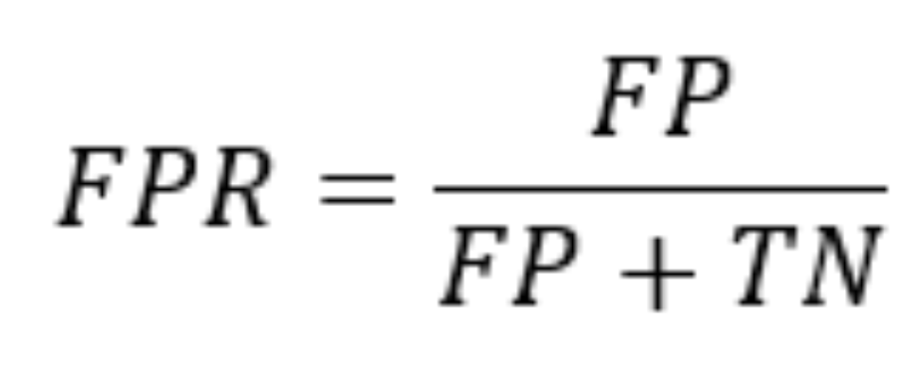
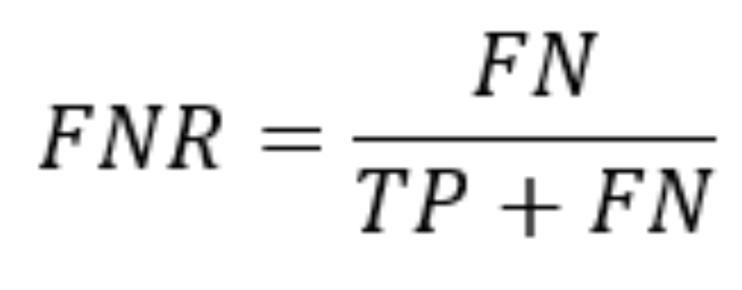
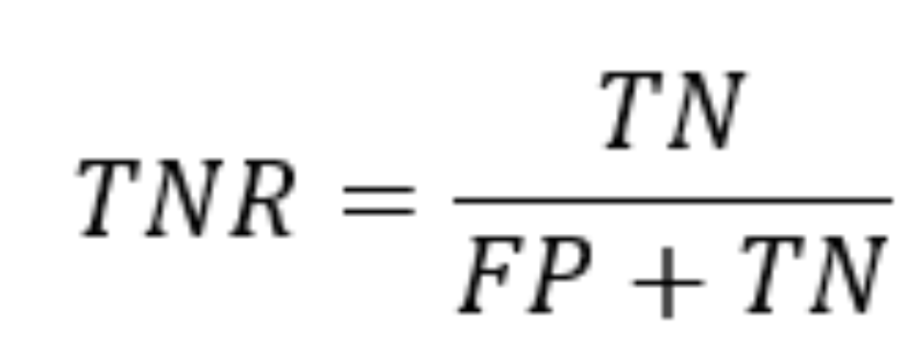
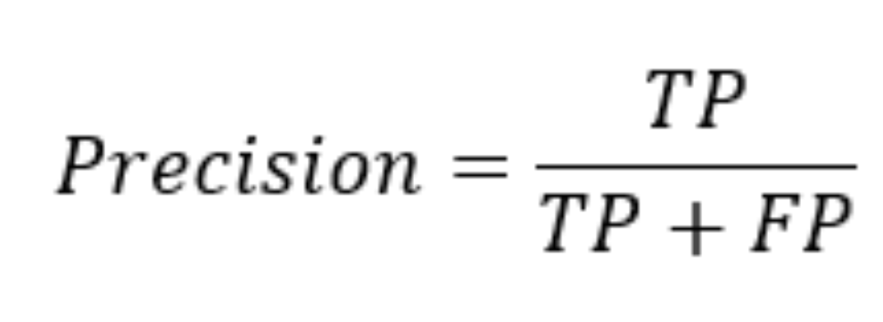
Some Metrics we can derive from Confusion Matrix
Accuracy tells the percentage of correctly predicted be the values out of all the data points. Often times, it may not accurate metric for our model performance
True Positive Rate : It tells us, out of all the positive data points, how many have been truly identified as positive by our model.
False Positive Rate : It tells us, out of all the Negative points, how many have been falsely identified as positive by our model.
True Negative Rate : It tells us, out of all the negative points in our data set, how many have been truly identified as negative by our model.
False Negative rate : It tells us, out of all the positive points, how many have been falsely identified as negative by our model
Precision: It tells use, out of all the points which have been identified as positive by our model, how many are actually true

Slide 12
Advantages:
Simplicity: KNN is straight forward that makes it easy to understand and implement
No training phase: it doesn’t require an explicit training phase. The algorithm stores the data directly and perform computations during prediction.
Non parametric
Interpretable: it relies on simple and intuitive concepts such as distance and nearest neighbors. The prediction can be explained easily

Slide 13
Disadvantages:
Computational complexity: complexity increases as the size of training data sets increases. For large data sets, calculating distances between data points can be time consuming.
Memory intensive: it requires storage to store the training data set in memory. As we increase the size of training data set memory requirement also increases.
Curse of dimensionality: it affected by the curse of dimensionality, where the performance deteriorates as the number of features increases, making it difficult to find meaning nearest neighbors.

Slide 14
Application of KNN
Text mining
Agriculture
Finance
Medical
Facial recognition
Recommendation systems (Amazon, Hulu, Netflix, etc)

